Slide 1
Parallel Processing
Parallel processing can be described as a class of techniques which enables the system to achieve simultaneous data-processing tasks to increase the computational speed of a computer system.
A parallel processing system can carry out simultaneous data-processing to achieve faster execution time. For instance, while an instruction is being processed in the ALU component of the CPU, the next instruction can be read from memory.

Slide 2
The primary purpose of parallel processing is to enhance the computer processing capability and increase its throughput, i.e. the amount of processing that can be accomplished during a given interval of time.
A parallel processing system can be achieved by having a multiplicity of functional units that perform identical or different operations simultaneously. The data can be distributed among various multiple functional units.

Slide 3
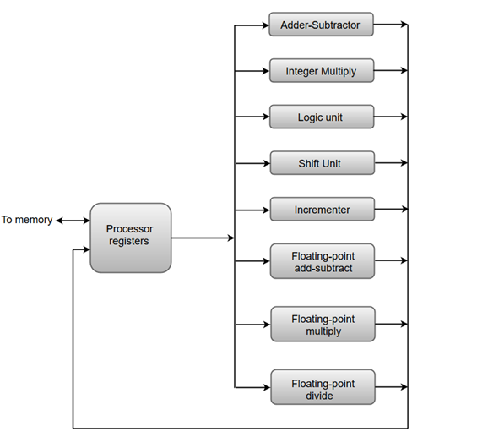
The following diagram shows one possible way of separating the execution unit into eight functional units operating in parallel.

Slide 4
The adder and integer multiplier performs the arithmetic operation with integer numbers.
The floating-point operations are separated into three circuits operating in parallel.
The logic, shift, and increment operations can be performed concurrently on different data. All units are independent of each other, so one number can be shifted while another number is being incremented

Slide 5
Flynn’s classification of parallel processing
Multiprocessing can be defined using Flynn’s classification, it is based on multiplicity of instruction stream and data streams in a computer system.
An instruction stream is a sequence of instruction executed by computer.
A data stream in a sequence of data which includes input data or temporary results.

Slide 7
They are classified into 4 types:
SISD (Single Instruction Single Data)
SIMD (Single Instruction Multiple Data)
MISD (Multiple Instruction Single Data)
MIMD (Multiple Instruction Multiple Data)

Slide 8
SISD:a single data stream is being processed by one instruction stream.
A single processor (uniprocessor) in which single stream of instruction is generated from a program.
SIMD:Each instruction is executed on different set of data by different processor.
This group is dedicated to array processing machines.
MISD:Each processor executes a different sequence of instructon.
Multiple processing unit operate on one single data stream.
MIMIDEach processor has a separate program.
An instruction stream is generated in each program.
Each instruction operate in different data

Slide 9
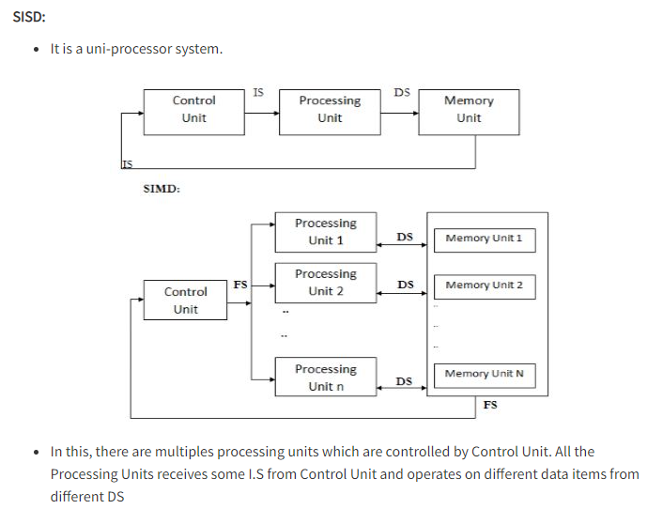

Slide 10
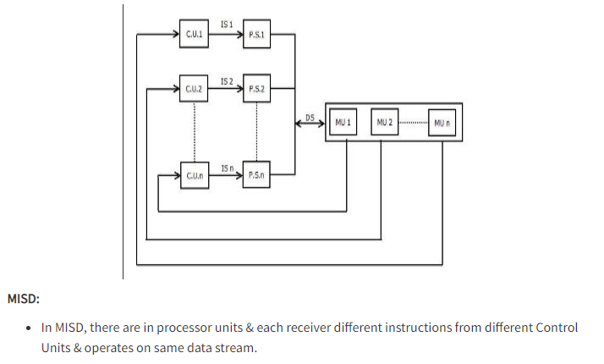

Slide 11
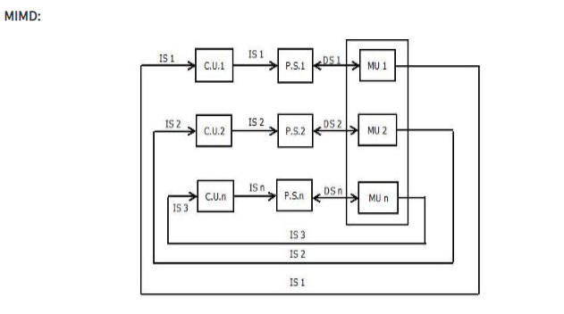

Slide 12
Pipelining
The term Pipelining refers to a technique of decomposing a sequential process into sub-operations, with each sub-operation being executed in a dedicated segment that operates concurrently with all other segments.
The most important characteristic of a pipeline technique is that several computations can be in progress in distinct segments at the same time. The overlapping of computation is made possible by associating a register with each segment in the pipeline. The registers provide isolation between each segment so that each can operate on distinct data simultaneously.
The structure of a pipeline organization can be represented simply by including an input register for each segment followed by a combinational circuit.

Slide 13
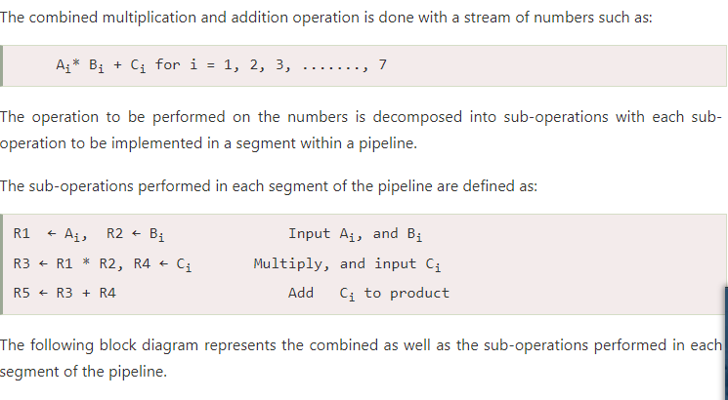
Let us consider an example of combined multiplication and addition operation to get a better understanding of the pipeline organization.

Slide 14
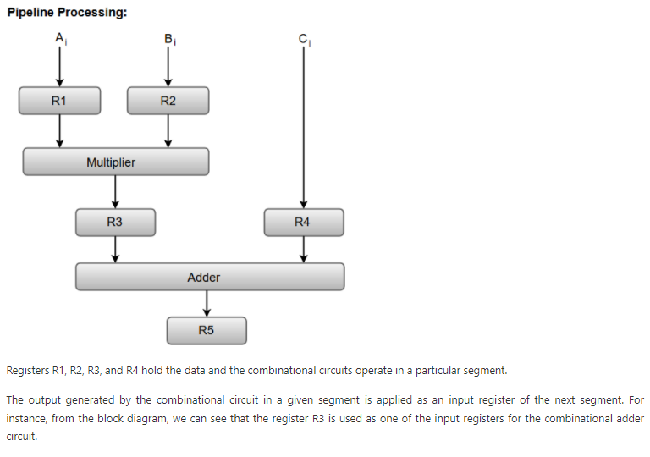

Slide 15
Instruction pipeling
Pipeline processing can occurs not only in data stream but in the instruction stream as well.
An instruction pipeline reads consecutive instruction from the memory while previous instruction are being executed in other segment.
This cause the instruction fetch and execute phase to overlap and perform simultaneous operations.
Computer needs to process each instruction with following sequence of steps

Slide 16
It can fetch instruction from memory.
It can decode instruction.
It can calculate effective addresses.
It can fetch operands from memory.
It can execute the instruction.
It can save the result in a suitable place

Slide 17
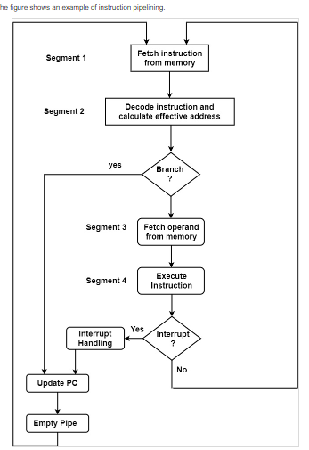

Slide 18
Segment 1
The instruction fetch segment can be executed using a first-in, first-out (FIFO) buffer.
Segment 2
The instruction fetched from memory is decoded in the second segment. The effective address is computed in an independent arithmetic circuit.
Segment 3
An operand from memory is fetched in the third segment.
Segment 4
The instructions are finally implemented in the final segment of the pipeline organization.

Slide 19
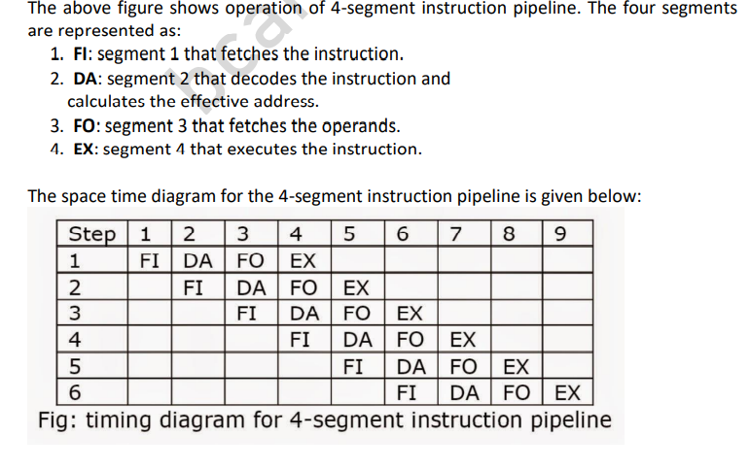

Slide 20
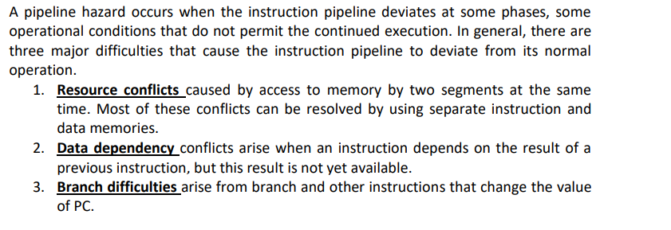
Pipeline conflict(Hazard)

Slide 21
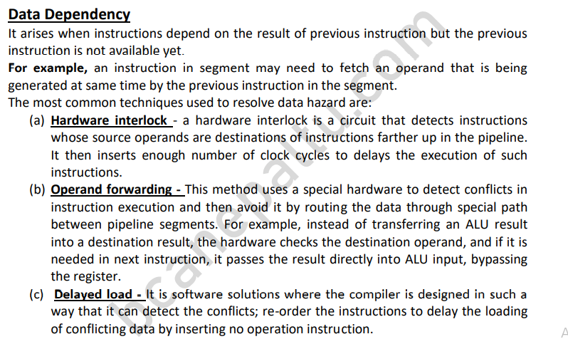

Slide 22
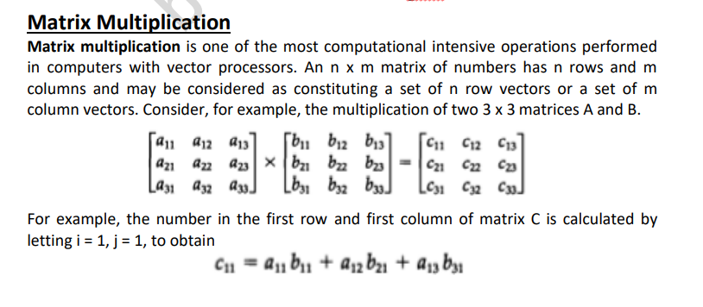

Slide 23
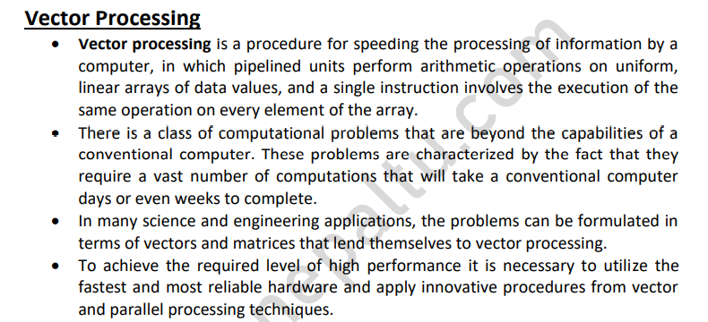

Slide 24
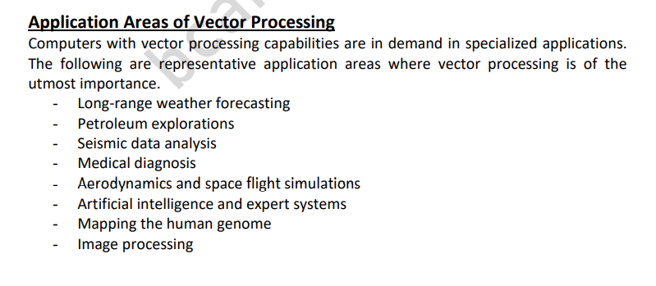

Slide 25
